Slide 1


NCAA Bracket Predictor
Nate Lang, John Hattas, Kevin Brosam, Alex Berkhout, Matt Petter

Slide 2
User Stories
Alex is interested in seeing how different indicators affect the predicted bracket. He wants to be able to select many different combinations of indicators and weights to vary the output bracket, so he can compare different possibilities. He would also like to be able to compare these outputted brackets against past seasons to get a general idea of how accurate it might be. Most importantly, he needs many different options for statistics that he would be able to use as indicators

Slide 3
Tests

Slide 4
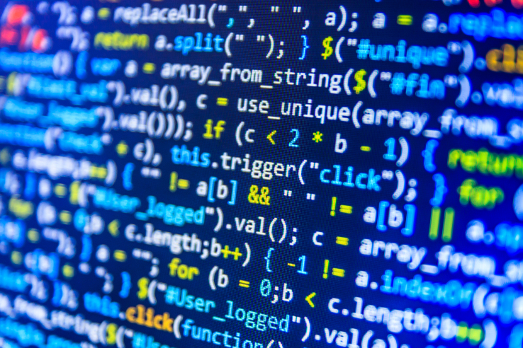
PRODUCT DEMO

Slide 5

Kaggle

Slide 6
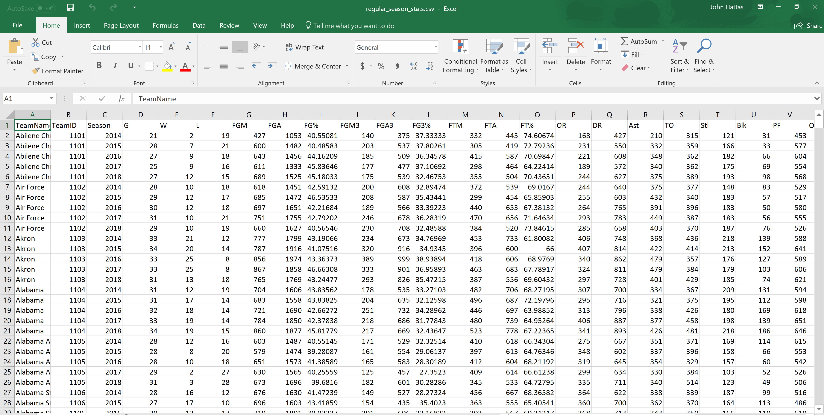
Our finished formatted csv ~1750x35

Slide 7
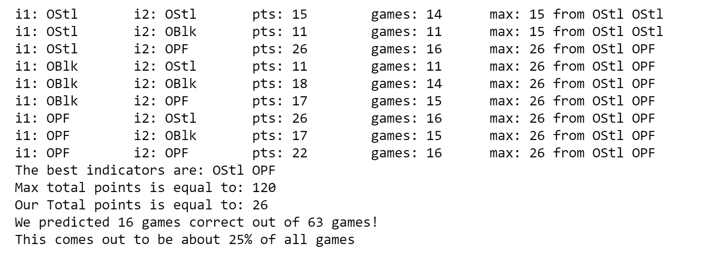
Example output testing combos of indicators

Slide 8
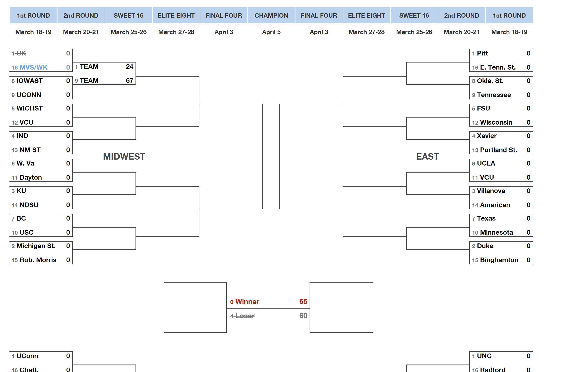
HTML bracket to visualize data in future sprints

Slide 9
Backlogs
Sprint Backlog
Task | Priority [1-10 (1 being lowest)] | Completed(Y/N)
Create extra stats column | 7 | N
Weighting system for indicators | 5 | N
Basic Machine Learning algorithm | 4 | N
Multiple working indicators | 10 | Y
Create SRS, SOS, RPI methods | 7 | Y (Partly)
Optimize code | 7 | Y
Import Kaggle Data, adapt code | 10 | Y
Run against multiple years | 3 | Y
Brain storm about “intangible stats” | 4 | N

Slide 10
Product Backlog
Task | Priority [1-10 (1 being lowest)] | Completed(Y/N)
Develop an algorithm that predicts previous tournaments results | 1 | N
Integrate more advanced statistics | 7 | Y
Create picture of the bracket with appropriate teams | 7 | N
Collect Data | 10 | Y
Have a basic working model | 10 | Y
Back test for better prediction results | 4 | N
Potentially display through HTML | 1 | N
Update for 2018 tournament | 3 | Y
Compare different basic algorithms to find the easiest while not losing accuracy | 8 | N
Display data in charts and tables, potentially using R | 5 | N
Add location as one of the indicator | 2 (if reasonably possible) | N
Create User Interface | 4 | N

Slide 11
Sprint Retrospective
Paired Programming
Semi Daily Scrums-more often then Sprint 1
Bot in chat to remind us to do daily scrums
Spring Break – sprint went by fast
Optimistic about future
Goals for next Sprint are refinement and testing

